Slide 1


HAND BOOK
WHATSAPP BUSINESS API
+

Slide 2

WHY
WHATSAPP BUSINESS API.

Slide 3





Saudi Arabia Social Statistics 2020
TOTAL POPULATION
ACTIVE INTERNET USERS
ACTIVE SOCIAL MEDIA USERS
AVARAGE DAILY TIME SPENT ON INTERNET
AVARAGE DAILY TIME SPENT ON SOCIAL MEDIA
34.54
MILLION
32.23
MILLION
25.00
MILLION
7H 46M
3H 02M
100%
93.31%
72.38%
https://www.globalmediainsight.com/blog/saudi-arabia-social-media-statistics/

Slide 4
Saudi Arabia WhatsApp Users Messaging Apps
https://www.globalmediainsight.com/blog/saudi-arabia-social-media-statistics/

Slide 5
26,000,000+
WhatsApp Users in Saudi Arabia

Slide 6
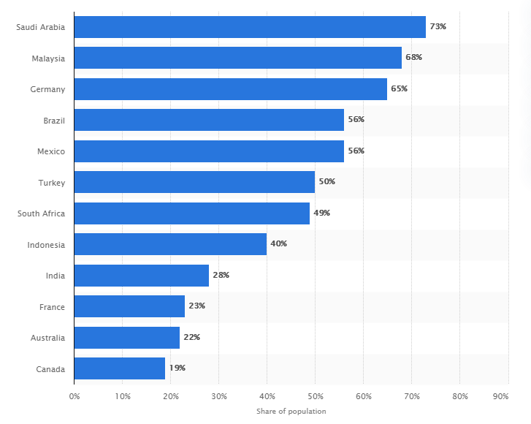
Active WhatsApp users as of 3rd quarter 2017

Slide 7
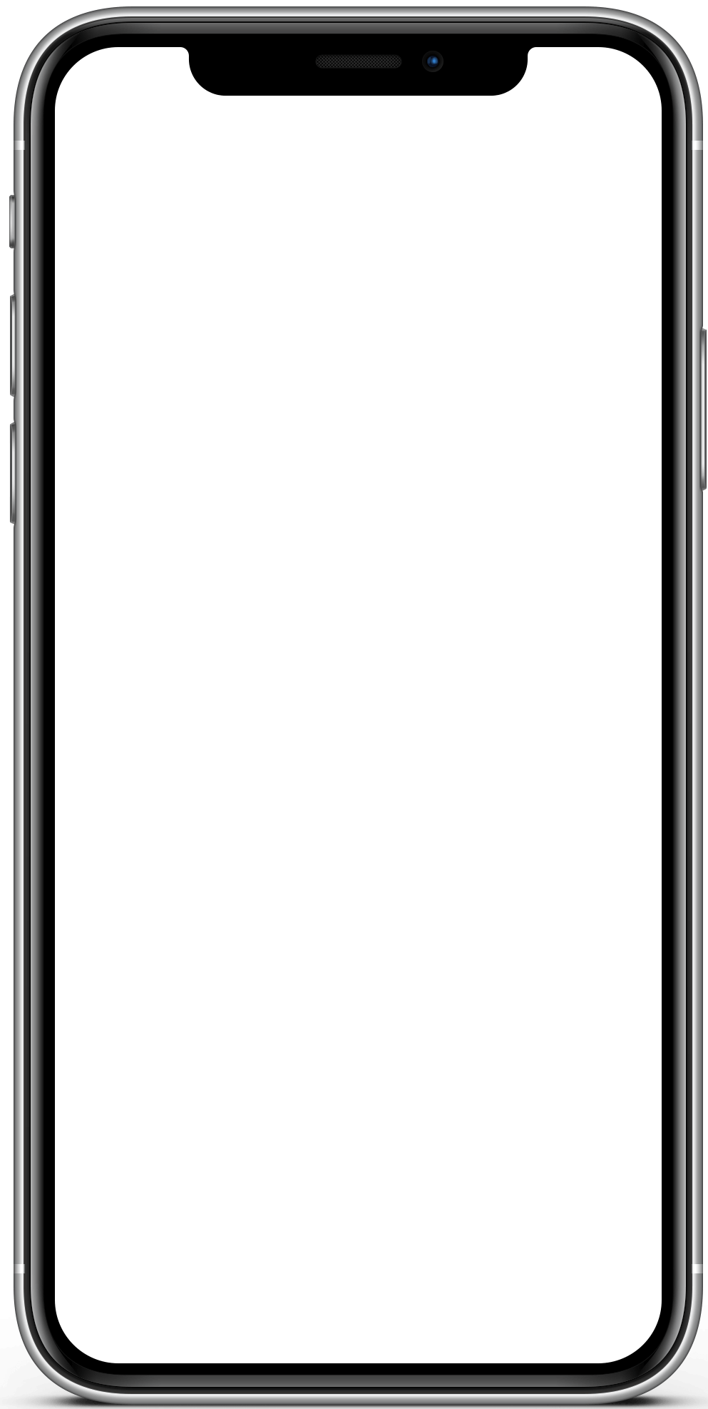

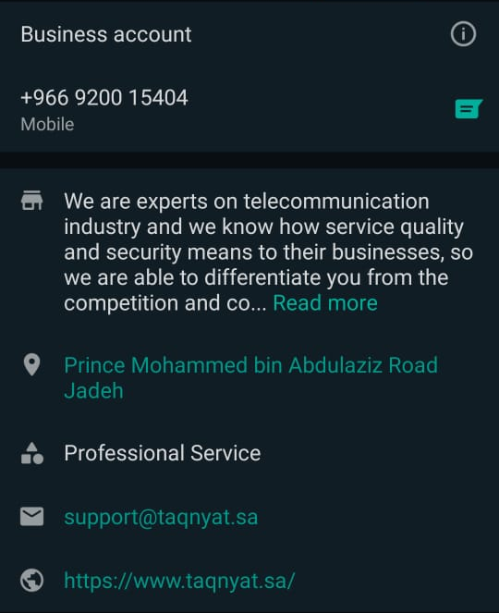
Present your Brand on WhatsApp
Medium and large businesses can communicate with customers at scale with the WhatsApp Business API.
TAQNYAT

Slide 8

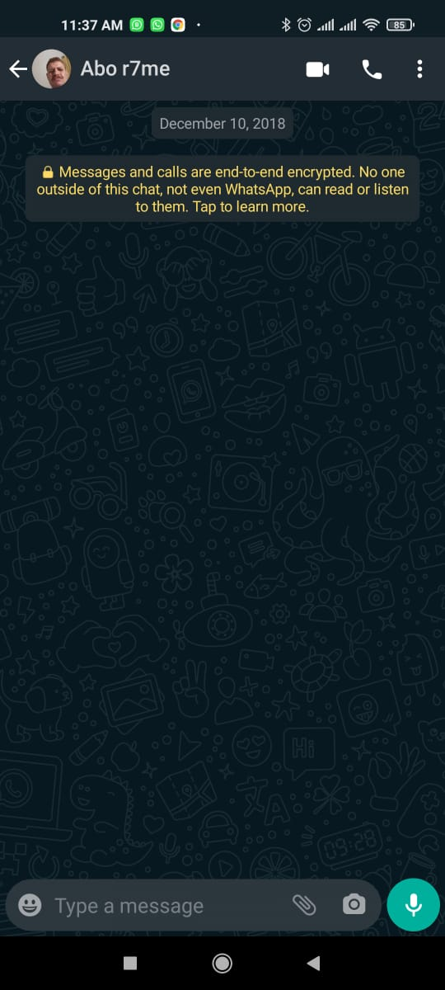
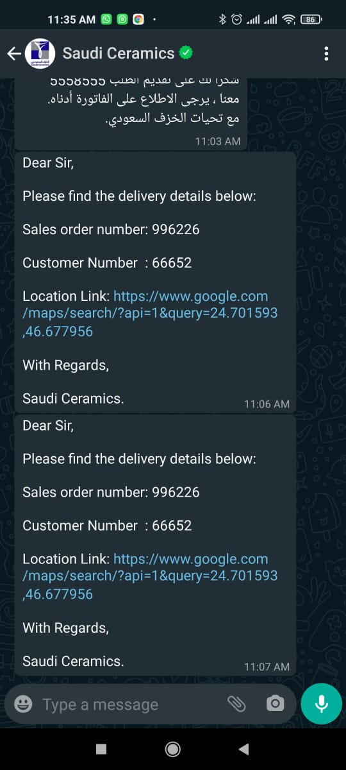



Type of Media messages
Text
Voice
Images
Videos
Documents (PDF, DOC, DOCX)
Mix (Media + Text)
TAQNYAT
MAY 2021.pfd
This is your invoice for may 2021
1:33 PM

Slide 9
HOW ITS WORK
WHATSAPP BUSINESS API.

Slide 10


Customer care
Customer initiated conversations that are :
Auto Opt-in customer for 24 hours.
Open a session for 24h as a last message received from customer
Allow Business to send Unbound with templates messages
.
TAQNYAT
Hello what is the official
working hours
1:33 PM
Hollo Sir ,
Good to hear from you
Our working hours are
SUN – THR
09:00 AM to 05:00 PM
Is their anything else I can
Help you with ?
1:33 PM
No , Thanks
1:34 PM

Slide 11
Notification
Business initiated conversations that are :
Need pre Opt-in the customer.
Need a verified Template
You can define as many as you like of templates to send.
Once customer response to your message you may back to Unbound messages
TAQNYAT
Dear Mr.
Your order 552254 has been top-up successfully for more details please go to your account at our portal
https://portal.taqnyat.sa/
1:33 PM

Slide 12

FLOW
Customer care

Slide 13






Customer care flow
ENTRY POINT
Drive Message Efficiency
EXIT POINT
Build WhatsApp Channel awareness
How do manage the business to customer conversation thread?
How to you integrate your backend sales and service systems?
TICKET
CRM

Slide 14



Customer care messages enable businesses
Resolve issues one-on-one with private conversations.
Collect data (name , location …etc.) , Feedback or Reviews.
Explore products , services and make requests

Slide 15



Customer care messages Benefits
Increase in customer satisfaction
Increase in customer service operational efficiency
Increase in customer lifetime value

Slide 16

Notification

Slide 17



Notification messages enable businesses
Deliver important, timely messages
Continue the conversation with customers who respond to your notifications
Initiate conversation with your customers

Slide 18









Template categories
Issue Resolution
Personal Finance Update
Reservation Update
Shipping Update
Ticket Update
Account Update
Alert Update
Payment Update
Appointment Update
Transportation Update

Slide 19
Customer opt-in roles
1
2
3
Customers must explicitly opt-in to notifications
Obtaining user consent must be completed outside of WhatsApp
Ads that click to WhatsApp cannot be used to obtain opt in

Slide 20
Customers must explicitly opt-in to notifications
1
2
3
User Action
Explicit Language
Visual Indication
Must be triggered by a
customer action
I agree to receive [noun], [logo and name], on [number]"
A visual element shown next to the WhatsApp name and logo
EXAMPLE
EXAMPLE
EXAMPLE
checking an ‘I agree’ box
“ I consent to receive order updates from Taqnyat on my WhatsApp number ”
Receive confirmation on WhatsApp
Phone number
+966 00 0000000

Slide 21



Obtaining user consent must be completed outside of WhatsApp
While setup user profile and preferences
Email , SMS , Social Media , Website
Phone calls or interactive voice response (IVR)

Slide 22

Notification messages Benefits
Increase in customer satisfaction
Tracking and Increase the delivery, open and conversion rates
Increase in customer lifetime value

Slide 23

New Template Requirements
Template Name
New template
Name
Category
Language
Template Category
Content
Template Language
Dear {1}
Your order number {2} has been shipped on {3}.
Content and placeholders
SUBMIT

Slide 24
Template review status
English
Pending review , which take up to 72 working hours
English
Approved and active template
English
Rejected Template , response will be sent to Taqnyat inbox

Slide 25
Use cases
Notification

Slide 26

Airline Notification Usecases
BOOKING CONFIRMATIONS
BOARDING PASSES
TRAVEL UPDATES (flight cancellation, delays , gate changes , check-in)

Slide 27

Retailer Notification Usecases
DELIVERY NOTIFICATIONS
SHIPPING UPDATES
PURCHASE RECEIPTS
INVOICES COPY

Slide 28

Banks Notification Usecases
BANK TRANSACTIONS
TWO-FACTOR AUTHENTICATION
ACCOUNT STATEMENTS

Slide 29

Requirements for
Open WhatsApp Business API

Slide 30
Requirements
Verified Facebook Business Account
Accept WhatsApp Agreements
Phone Number (Unified , Mobile , Landline)
Business Brand Name
Business Use case for WhatsApp

Slide 31
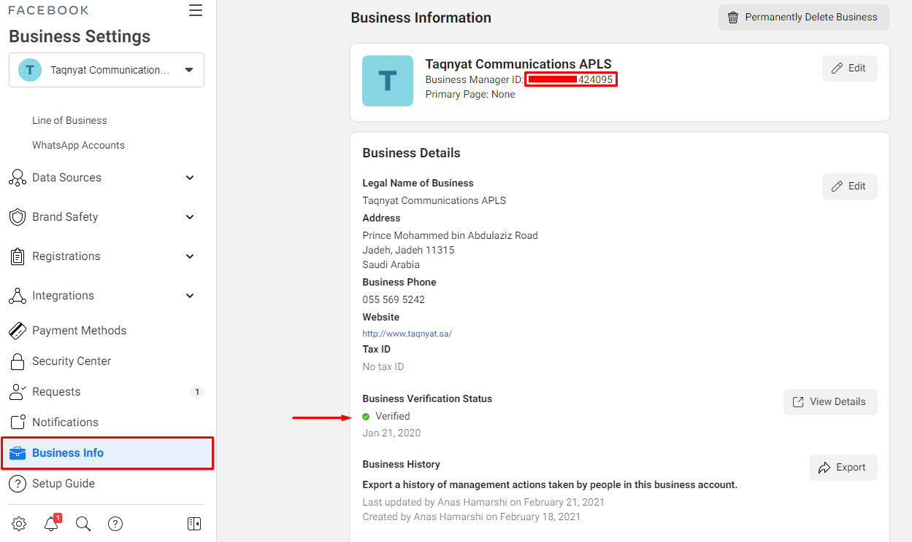
Verified Facebook Business Account
https://developers.facebook.com/docs/development/release/business-verification

Slide 32
Accept WhatsApp Agreements
WhatsApp Legal Agreement
https://www.whatsapp.com/legal/?fbclid=IwAR2Dmh67-GIUvUUzlJL63Zhs2bCHLwt9ioz6IIooDvpR_rXAXw66u4feS5I
WhatsApp Business Policy
https://www.whatsapp.com/legal/business-policy?fbclid=IwAR26jq6vcTx6oE9Ym7v8M-1fVGwTuHylA4pXfjMyN_VBacdPY2U0AXtBa-g
WhatsApp Commerce
https://www.whatsapp.com/legal/commerce-policy/?fbclid=IwAR0f5_SLZab9qR402ysC84IQNnwLwauEQpc0K04WDGH80fA48WY7ASgjUI8

Slide 33

Allowed Business Use case
Alerting your customers about travel itinerary changes, system outages, and other location-targeted information
Notifying your customers regarding their orders or deliveries, appointment reminders, payment processing etc.
Providing support to your customers through in-depth conversations. By being available on WhatsApp, you are easily reachable for your customers at any time, and your support agents can improve troubleshooting and shorten ticket lifespans
Engaging with leads more actively by building alerts to notify your sales team of new activity

Slide 34

use cases are not allowed
Marketing traffic or other subscription-style content
Adult content
Alcohol
Animal sales, including live animals, livestock, or any parts of animals
Currency
Dating
Defense
Drugs or related products
Digital subscription and digital content
Tobacco
Gambling
Weapons, ammunition, explosives

Slide 35

Taqnyat Business Models for
WhatsApp Business API

Slide 36
Taqnyat Business Models
Item | Recurring | Amount/Rate
Setup Fees | Once | 375 SAR
Subscription Fees | Monthly | 3000 SAR
Notification Messages | On Usage | WA + 0.01875 SAR / MSG
Customer Care Messages | On Usage | 0.01875 SAR / MSG
Monthly Active User | On Usage | First 5K Free + 0.10 SAR / Extra
https://developers.facebook.com/docs/whatsapp/pricing/#usd

